Slide 1

Automation Testing
By- Manas

Slide 2

Automation Testing ?
If a software can do anything then, why can’t a software test a software?
Does this statement sound logical to you?

Slide 3
WHAT IS AUTOMATION TESTING
Performing testing on the software application / product with the help of automation tools is called Automation testing.
Automation Testing is a software testing technique that performs using special automated testing software tools to execute a test case suite. On the contrary, Manual Testing is performed by a human sitting in front of a computer carefully executing the test steps.
Note:
In both manual and automation, we are performing same testing but the way we are performing testing is different from manual to automation.

Slide 4
Why Test Automation?
Test Automation is the best way to increase the effectiveness, test coverage, and execution speed in software testing. Automated software testing is important due to the following reasons:
Manual Testing of all workflows, all fields, all negative scenarios is time consuming
It is difficult to test for multilingual sites manually
Test Automation in software testing does not require Human intervention. You can run automated test unattended (overnight)
Test Automation increases the speed of test execution
Automation helps increase Test Coverage
Manual Testing can become boring and hence error-prone.

Slide 5
Automation Testing tools are divided into 3 types:
1. Functional Testing tools
2. API Testing tools
3. Performance/Security Testing tools

Slide 6
Functional Testing Tools
A tool which we are using to test the functionality of the application is called functional testing tool.
Example: Selenium, QTP (Quick Test Professional), UFT, RFT (Rational Functional Tester)

Slide 7
API Testing Tools
A tool which we are using to test the backend (API) functionality of the application is called API testing tool.
Example: Postman, Swagger, Rest assured etc.

Slide 8
Performance Testing Tools
A tool which we are using to test the performance of the application is called performance tool.
Example: Load Runner, Jmeter, Silk Performer etc.

Slide 9
Advantages of Automation Testing
Time Saving: By implementing automation testing we can save the time during performing testing in a project
Example: If we are executing 1 test case manually in 1-hour, same test case we can able to execute in 5 minutes with help of automation tool.
Repeatability/Reusability: If we want to execute the same test case repeatedly for multiple times, instead of going for manual testing we can go for automation testing. (Especially for Regression Testing)

Slide 10
Advantages of Automation Testing
Reducing Resources: By implementing automation testing the resources will be reducing to completed the testing in a project.
Accuracy: By implementing automation testing we can maintain the quality during performing testing in a project.
As a human some times we may make some mistakes during performing testing but tools never make any mistakes.

Slide 11
Advantages of Automation Testing
Reducing Production Defects: By implementing automation testing we can maintain the Quality so, that automatically the defects will be reduces.
Flexibility: Automation tools are more flexible than humans. That means we can able to execute our test scripts any time using automation tools.

Slide 12
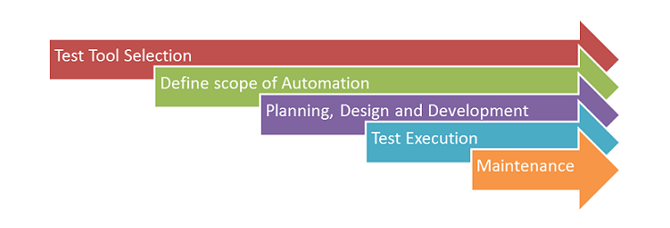
Automation Testing Process

Slide 13
Automation Testing Process
Following steps are followed in an Automation Process:
Step 1) Test Tool Selection
Step 2) Define scope of Automation
Step 3) Planning, Design and Development
Step 4) Test Execution
Step 5) Maintenance

Slide 14
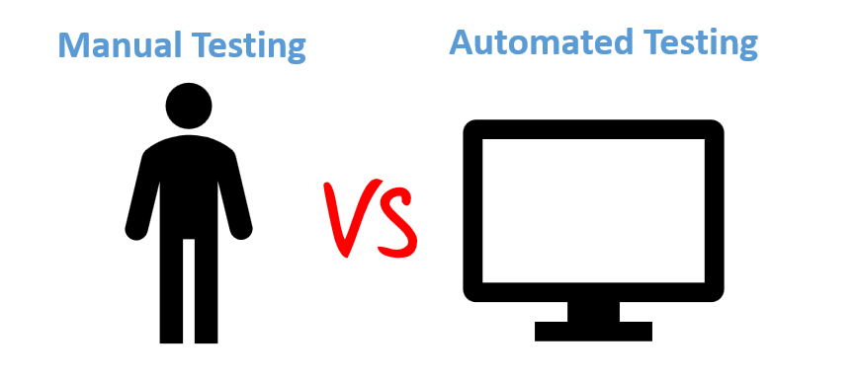

Slide 15
“Diff between Manual Testing and Automation Testing”
Manual Testing is done manually by QA analyst (Human) whereas Automation Testing is done with the use of script, code and automation tools (computer) by a tester.
Manual Testing process is not accurate because of the possibilities of human errors whereas the Automation process is reliable because it is code and script based.
Manual Testing is a time-consuming process whereas Automation Testing is very fast.
Manual Testing is possible without programming knowledge whereas Automation Testing is not possible without programming knowledge.
Manual Testing allows random Testing whereas Automation Testing doesn’t allow random Testing.

Slide 16
Disadvantages of Automation Testing
1. License cost of the automation tools. (To perform manual testing we need not to pay any licence but for performing automation testing we need to first purchase the licence of tool)
2. Some automation tools will not support some technologies. But manual tester can able to test any application which has developed in any technology.
3. To perform manual testing in a project we doesn’t required technical knowledge but to perform automation testing we should required technical knowledge (coding knowledge)
4. Without human element, it’s difficult to get insight into visual aspects of your UI like colors, font, sizes, contrast or button sizes.

Slide 17
Note:
Comparatively disadvantages we have more advantages with Automation Testing. That is the reason most of the clients prefer to implement automation testing along with manual testing.

Slide 18
FAQ’s:
What is Automation Testing
Automation testing is the process of using tools and scripts to automatically execute test cases, compare actual and expected results, and generate reports without manual intervention.
2. What is the difference between Manual and Automation Testing
Manual testing is performed by a human tester without scripts, whereas automation testing uses tools and scripts to execute test cases automatically. Automation is faster and suitable for repetitive and regression tests
3. What are the different types of Automation Tools available in Industry
Web Automation Tools – Selenium, Cypress, Playwright
API Automation Tools – Postman, RestAssured
Performance Tools – JMeter, LoadRunner
Mobile Automation Tools – Appium
4. Which Test management tool you are using in current project
JIRA, ALM, Code Beamer
5. What is difference between Functional and Performance testing
Functional testing verifies whether the application works according to requirements, whereas performance testing checks how the system behaves under load, stress, or high user traffic.
6. What are advantages of Automation Testing?
Automation testing saves time, increases test coverage, improves accuracy, supports regression testing, and allows parallel execution.
7. Do we have any disadvantages in Automation Testing
Automation requires initial investment, maintenance effort, skilled resources, and is not suitable for one-time or exploratory testing.

